Slide 1
Project 2: Bit-Banging I2C
Griffin Short, Gabe Story

Slide 2
Project Intro
Create an I2C program in assembly to transmit/receive data to/from the MPC7940N RTC (Real Time Clock).
Develop routines to implement the I2C protocol by manually controlling the SDA and SCL lines (bit banging).

Slide 3
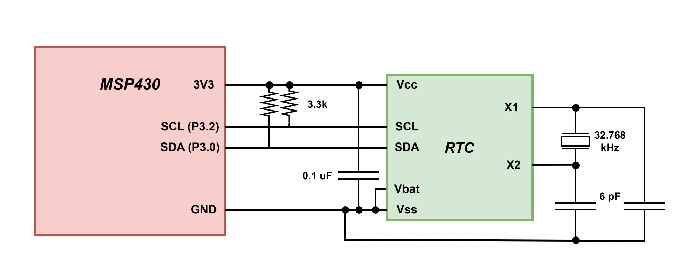
Circuit

Slide 4
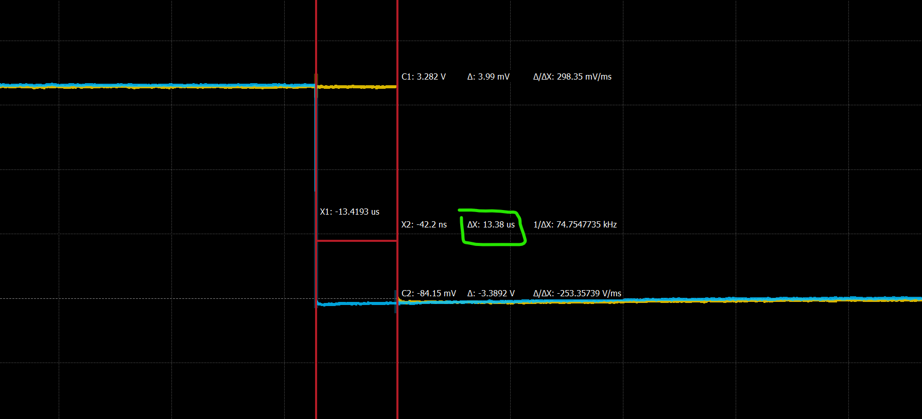
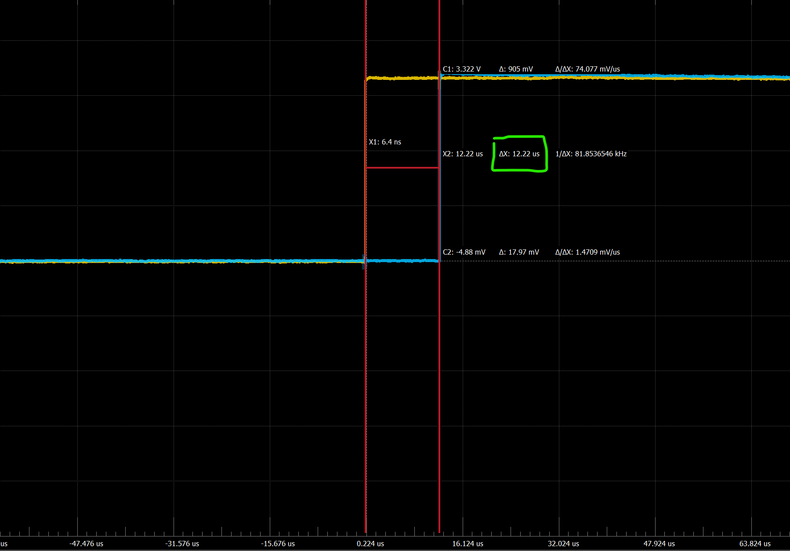
I2C Protocol Implementation
Create ‘Start’ and ‘Stop’ conditions
Blue = SDA, Yellow = SCL

Slide 5
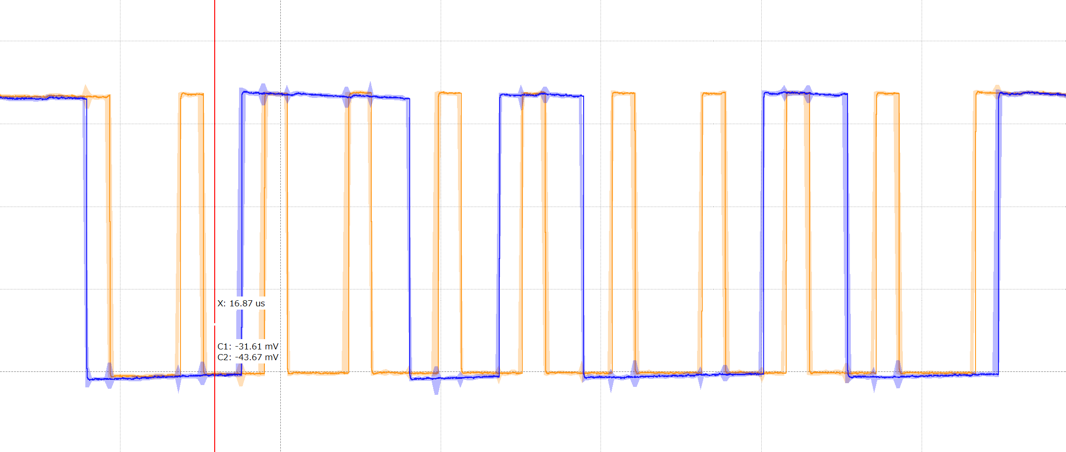
I2C Protocol Implementation (cont’d)
2. Transmit a random data packet (start, 8 bits + ACK/NACK, stop) and check that timing looks okay on scope

Slide 6
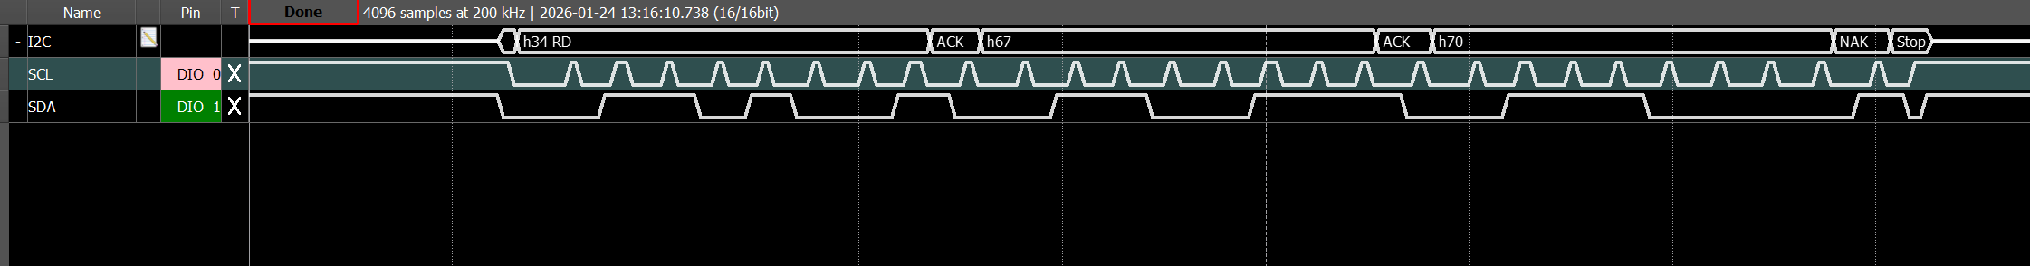
I2C Protocol Implementation (cont’d)
3. Transmit ‘N’ number of random bytes and check that logic analyzer is interpreting the data correctly.

Slide 7
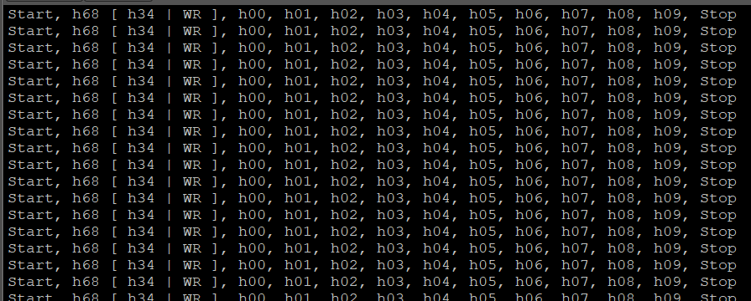
I2C Protocol Implementation (cont’d)
4. Live transmit the value of a counter from 0-9

Slide 8
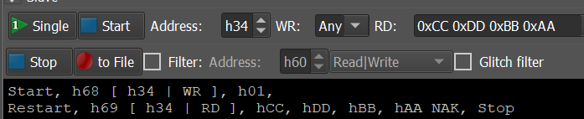
I2C Protocol Implementation (cont’d)
5. Request bytes from the AD2 and successfully read them.

Slide 9
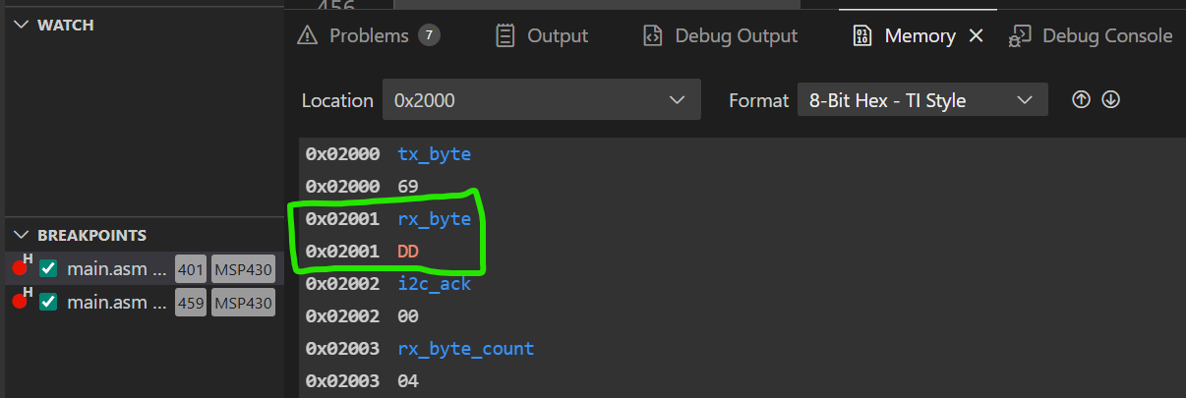
I2C Protocol Implementation (cont’d)
6. Save received bytes into memory.

Slide 10
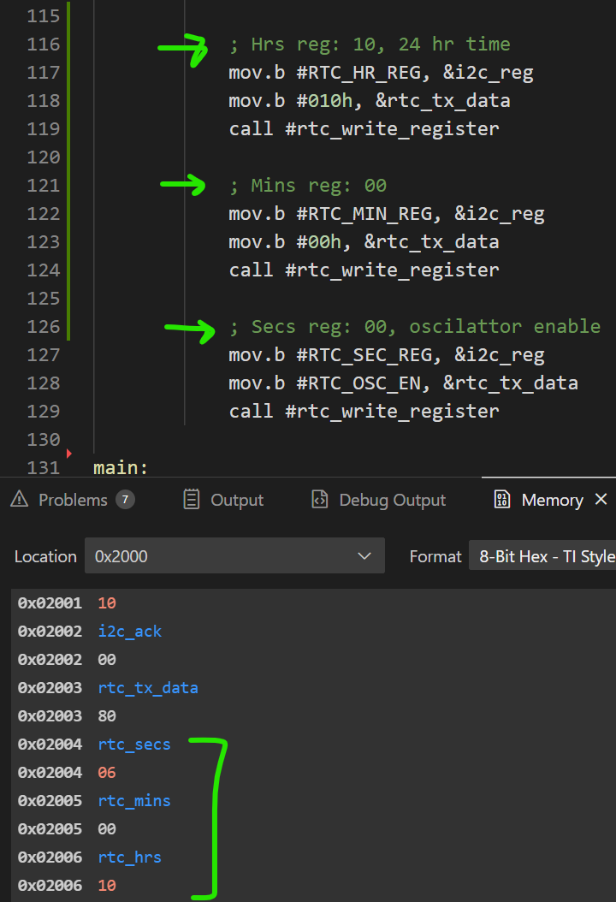
I2C Protocol Implementation (cont’d)
7. Reading and writing the RTC

Slide 11
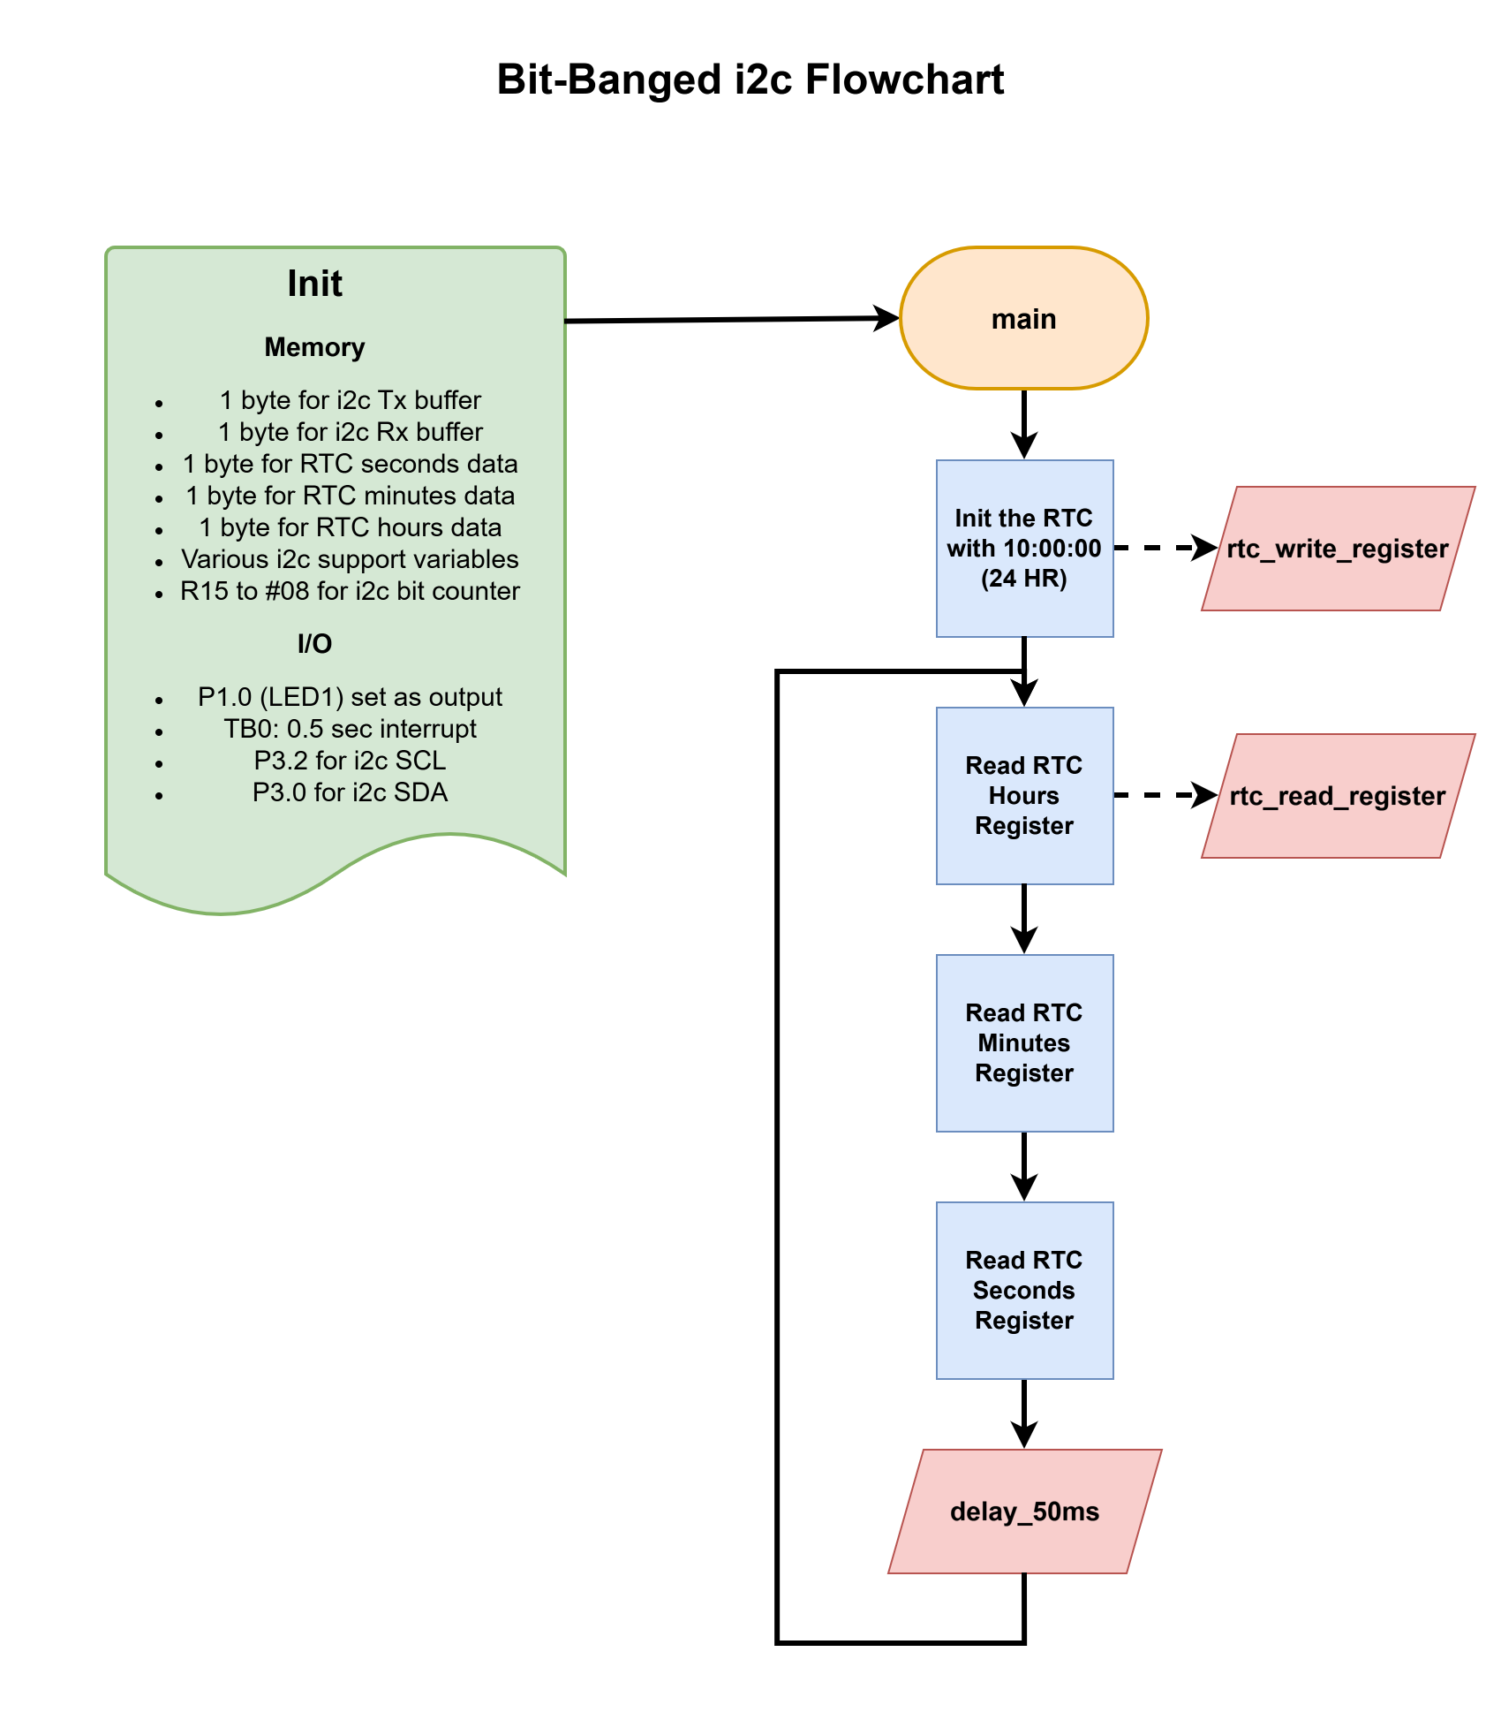
Main Program Flow

Slide 12
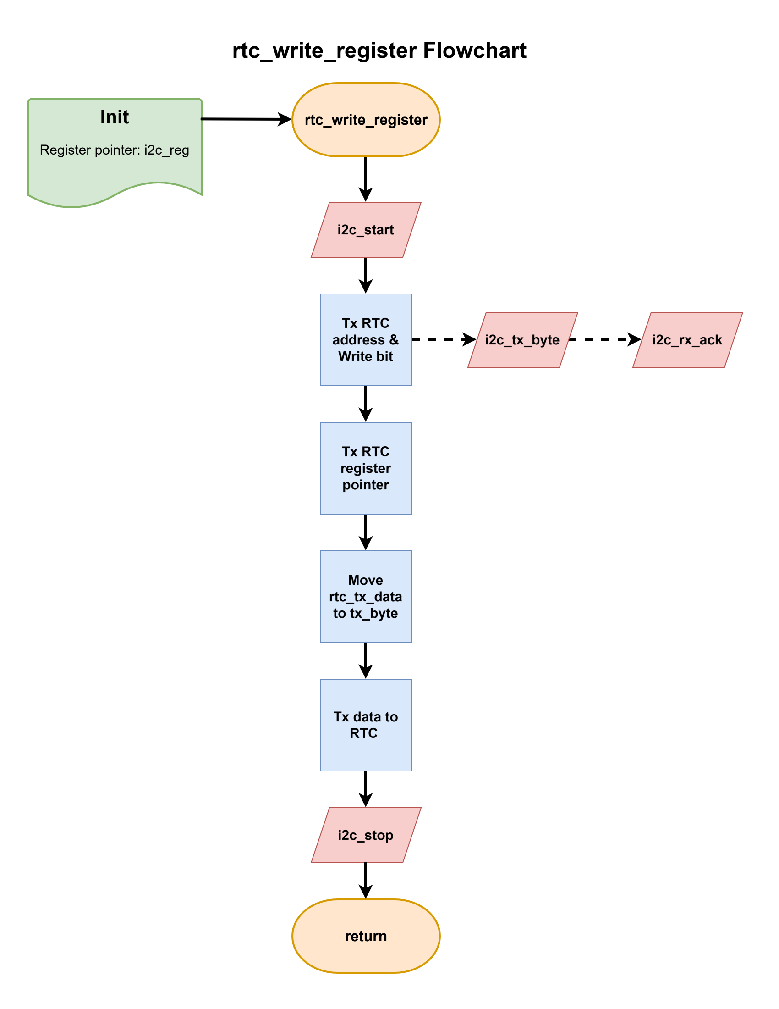
rtc_write_register

Slide 13
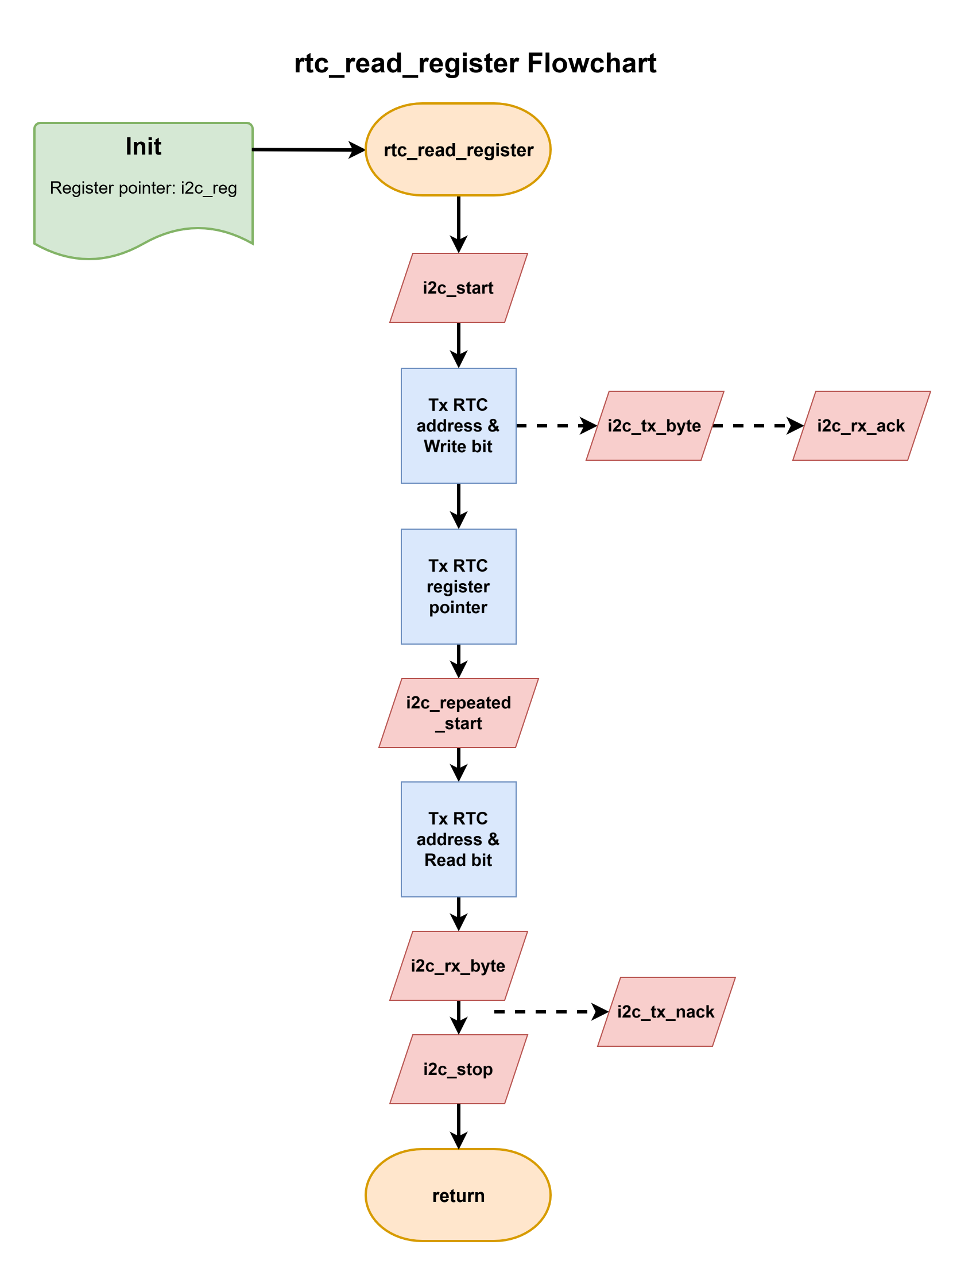
rtc_read_register

Slide 14
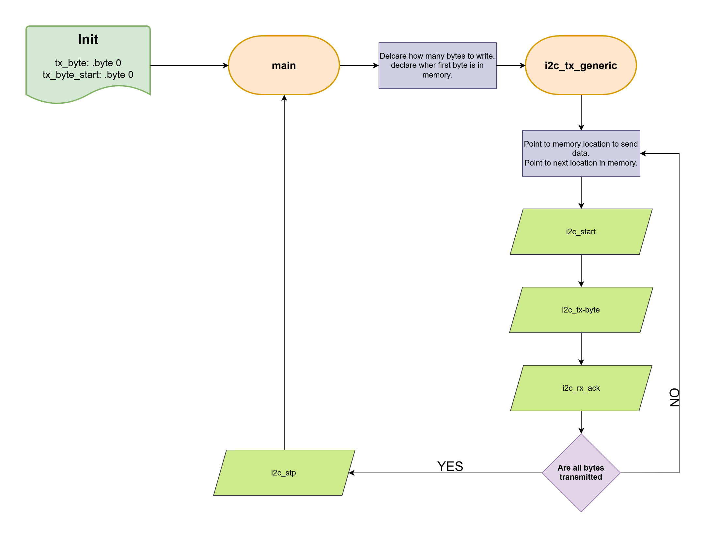
Generic Write

Slide 15
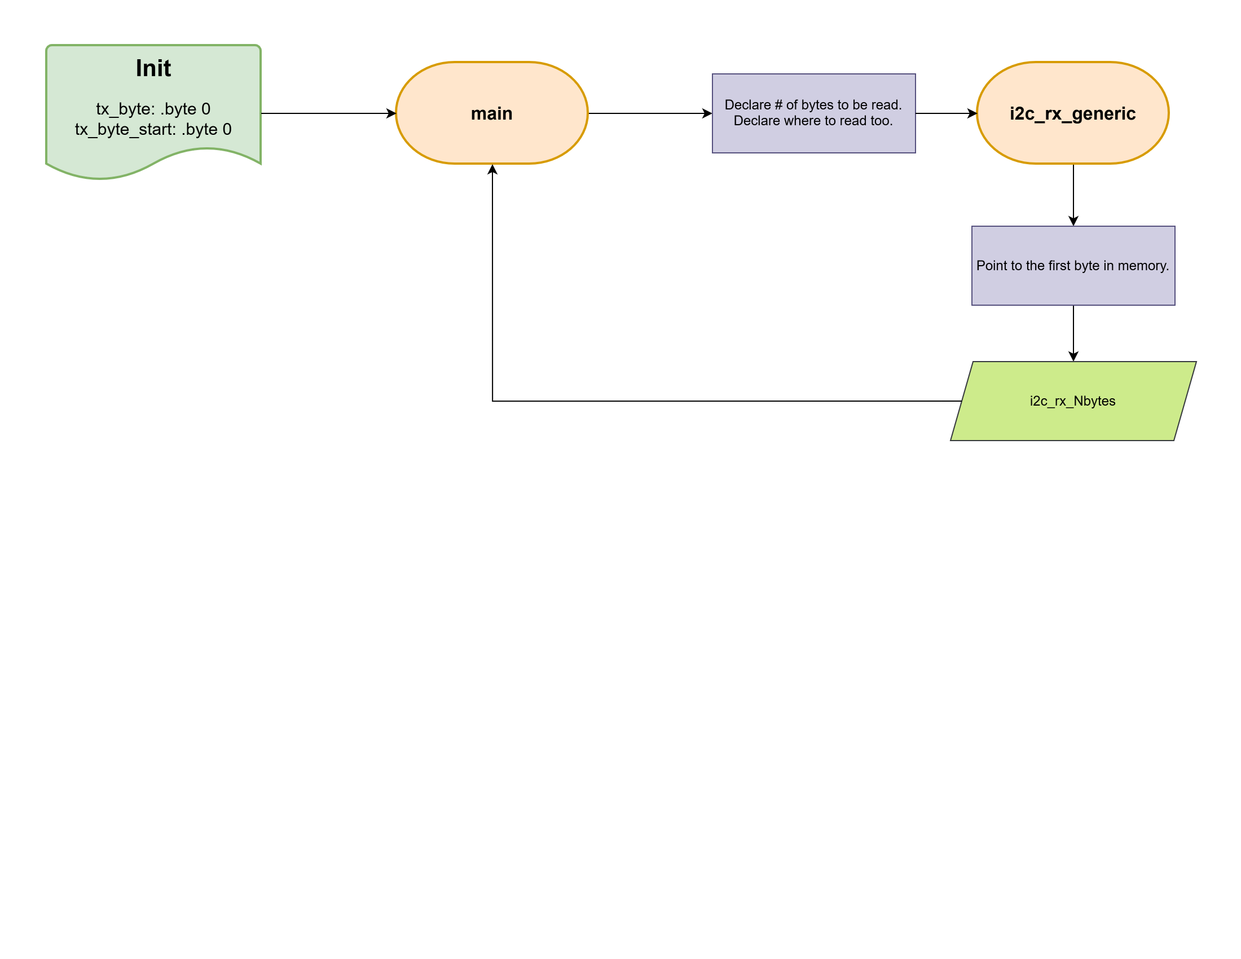
Generic Read

